Slide 1


IMPLEMENTATION OF SHANNON-FANO CODING FOR ECG SIGNALS USING MATLAB
GLADWIN JEBAS J, ECE
DANIEL DENCIL J, ECE

Slide 2
Outline
Introduction
Problem Statement
Market Survey
Shannon-Fano algorithm
Mathematical Model
Results and Discussions
Conclusions
References

Slide 3
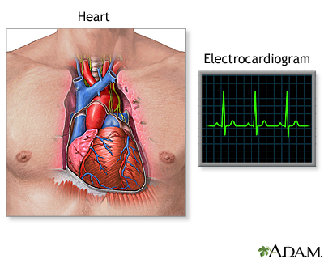
Introduction
What is ECG?
An electrocardiogram (ECG) is a test that records the heart's electrical activity and rhythm.
The efficient encoding of electrocardiogram (ECG) signals is critical for medical diagnostics, telemedicine, and wearable health devices, where minimizing storage and transmission costs is essential.
This project focuses on implementing Shannon-Fano coding, a foundational entropy-based encoding algorithm, for compressing ECG signals.
Shannon-Fano coding reduces data redundancy by assigning shorter codes to more frequent signal values, making it an ideal approach for compressing ECG data without compromising accuracy.

Slide 4
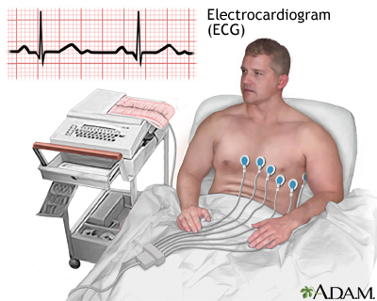
Problem Statement
Problem Statement:
The increasing use of ECG (electrocardiogram) data in health monitoring and diagnostics has led to a significant growth in data storage and transmission requirements.
Given that ECG signals are often recorded over extended periods, efficient data compression is crucial to reduce storage costs and enhance transmission speed without compromising signal quality.

Slide 5
Market Survey
With the growing demand for efficient healthcare data management and remote patient monitoring, the compression of ECG data is becoming increasingly important.
Traditional ECG systems generate large volumes of data, posing challenges in storage, transmission, and processing costs.
Wavelet Transform-Based Compression, Discrete cosine Transform Compression, are some of the existing encoding techniques in market
Shannon-Fano coding is also an encoding technique which is used in this project.

Slide 6
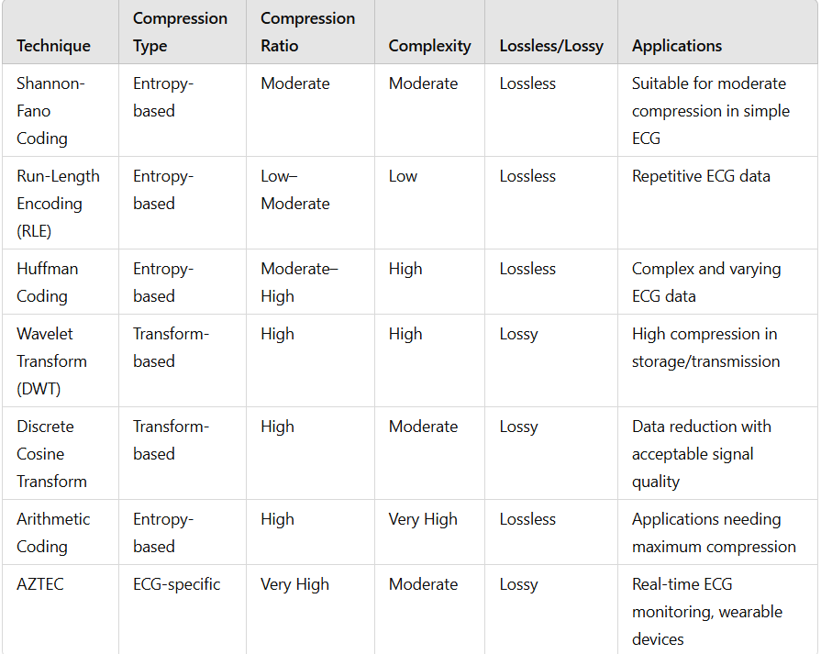
Market Survey

Slide 7
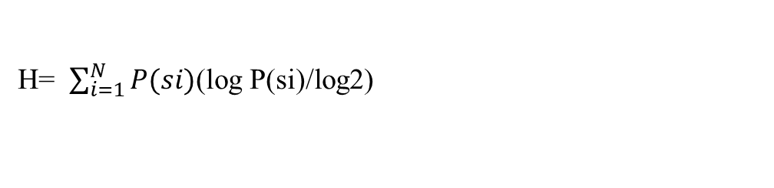
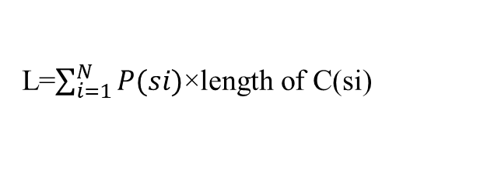
Shannon-Fano algorithm
Data Acquisition
Preprocessing the ECG Signal
Probability Calculation
Shannon-Fano Coding Implementation
Compression and Decompression Testing
Performance Evaluation
Calculate Entropy H
The average code length L
Efficiency
H= $\sum_{i=1}^{N}{P(si)}$(log P(si)/log2)
L=$\sum_{i=1}^{N}{P(si)}$​×length of C(si​)
Efficiency=H/L

Slide 8
Shannon-Fano algorithm
ECG data is loaded, sampled at 360 Hz, and plotted to observe signal characteristics.
Unique voltage levels (symbols) are identified, and their occurrence probabilities are calculated.
Recursive encoding assigns binary codes based on symbol probabilities, with left groups receiving '0' and right groups '1'.Each ECG symbol is mapped to its binary code, creating a compressed data format.
Entropy and average code length are computed to assess compression efficiency; redundancy is analyzed to gauge optimization potential.
A reverse lookup table enables accurate decoding, reconstructing the original ECG data.

Slide 9
Mathematical Model
Problem:
A set of symbols S={A,B,C,D,E} with the following probabilities: P(A)=0.4,P(B)=0.2,P(C)=0.2,P(D)=0.1,P(E)=0.1
Step 1: Sort Symbols by Probability
A:0.4, B:0.2, C:0.2, D:0.1, E:0.1
Step 2: Recursive Partitioning
First Split: Divide the list into two groups with near-equal probability sums:
Group 1: A (0.4)
Group 2: B,C,D,E(0.6)
Assign:
Group 1: Code "0" for A
Group 2: Code "1" for B, C, D, E

Slide 10
Mathematical Model
Second Split (on Group 2): Now, take Group 2 and divide it further:
Group 2.1: B, C (0.4)
Group 2.2: D, E (0.2)
Assign:
Group 2.1: Code "10" for B and "11" for C
Group 2.2: Code "110" for D and "111" for E
Step 3: Assign Codes to Each Symbol
Symbol | Probability | Code
A | 0.4 | 0
B | 0.2 | 10
C | 0.2 | 11
D | 0.1 | 110
E | 0.1 | 111

Slide 11
Mathematical Model
Step 4: Calculate Average Code Length
The average code length L can be calculated using:
Substituting in values:
L= (0.4×1) +(0.2×2) +(0.2×2) +(0.1×3) +(0.1×3) L=0.4+0.4+0.4+0.3+0.3=1.8 bits
Step 5: Calculate Entropy H
The entropy H provides the theoretical minimum for the average code length:
𝑃(𝑠𝑖)×length of C(si)
𝑃(𝑠𝑖)(log P(si)/log2)

Slide 12
Mathematical Model
Calculating for each symbol
H= (0.4×log0.4/log2) + (0.2× log0.2/log2) + (0.2× log0.2/log2) + (0.1× log0.1/log2) + (0.1× log0.1/log2)
After calculating each term, we get: H≈1.85
Step 6: Calculate Efficiency
The efficiency of the Shannon-Fano coding is:
Efficiency=H/L=1.85/1.8≈1.03

Slide 13
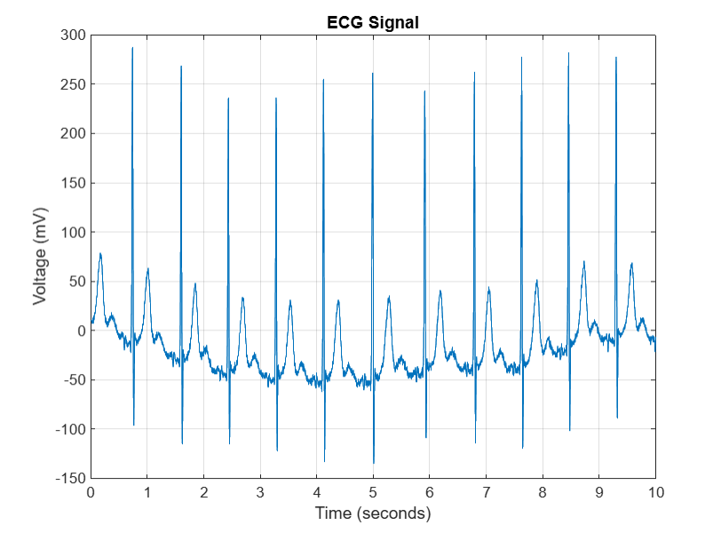
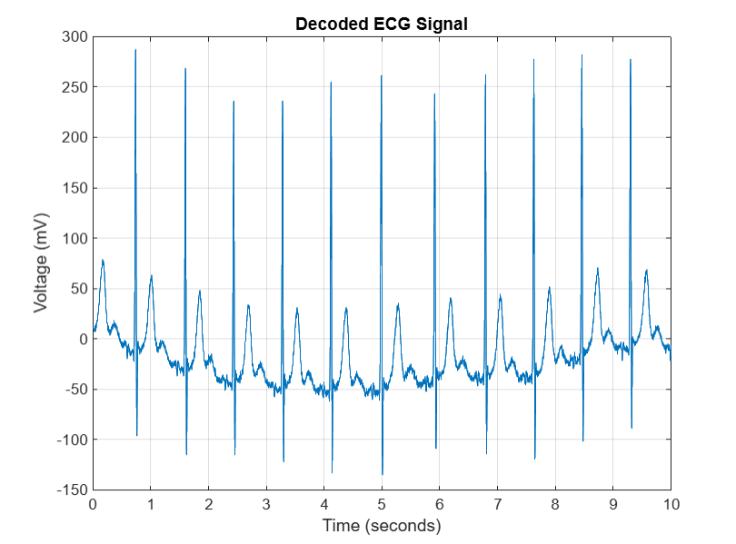
Results and Discussions

Slide 14
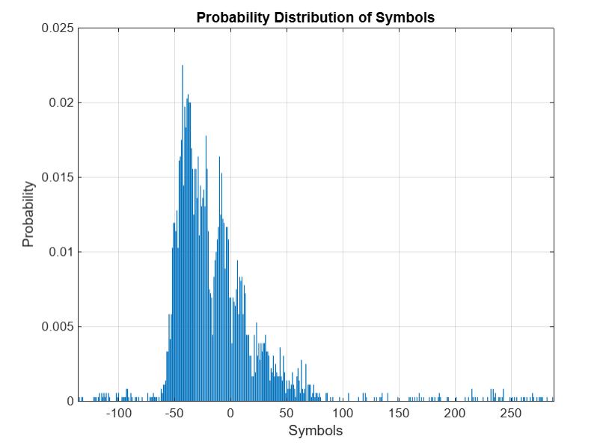
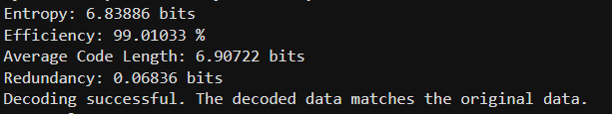
Results and Discussions

Slide 15
Conclusions
The implementation of Shannon-Fano coding for ECG signal compression successfully reduces data storage requirements and transmission costs while preserving signal fidelity and minimizing error.
Successful decoding confirms that the reconstructed signal closely matches the original, validating Shannon-Fano coding as a reliable approach for ECG data compression with reduced error.
Overall, this project highlights the potential of Shannon-Fano coding to enhance ECG data management and serves as a basis for future research and applications in medical data compression.

Slide 16
References
https://ieee-dataport.org/documents/ecg-signals-744-fragments
Digital Communication System by Simon S Haykin

